Slide 1


Wireless Insecurity: Breaking the Barrier to Entry
Ben Eldritch

Slide 2

READ_ME
This workshop includes APs (Access Points) that you MAY attack
SSIDs of APs that I am giving you full permission to attack:
TheLANBeforeTimeLand
GammaKnife
The Castle In The Air
You MAY NOT and should NEVER attempt to attack or exploit anything that is not yours without explicit permission – that includes any SSID outside of those listed above!
Be respectful to others around you and do not attempt to actively de-authenticate/DOS other folks in the room

Slide 3

Workshop Overview
WEP
WPS
WPA-PSK
Wired Equivalent Privacy
Wi-Fi Protected Setup
Wi-Fi Protected Access – PreShared Key

Slide 4




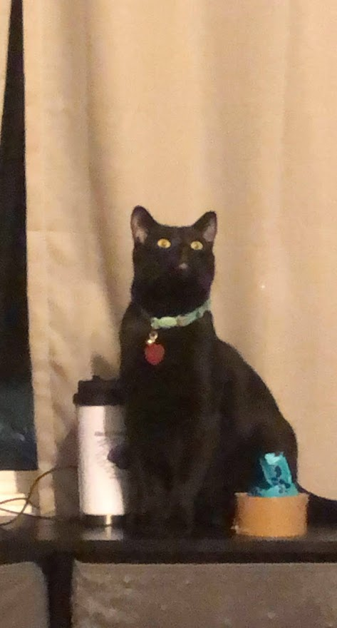
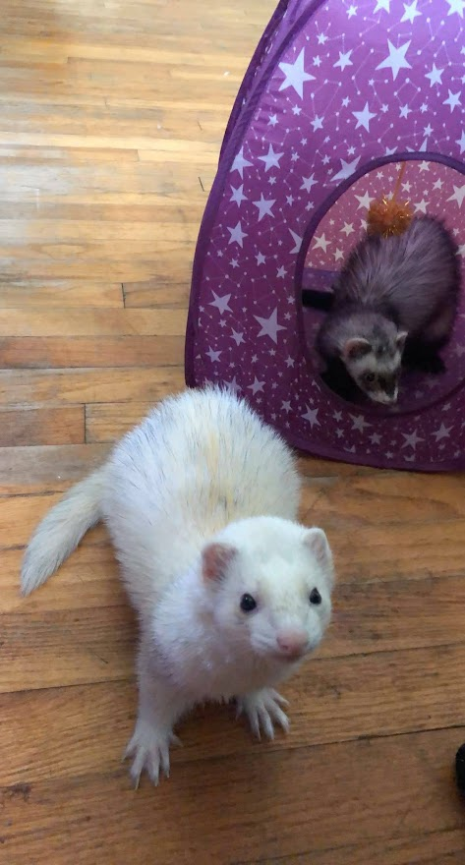
Whoami /all
About Me:
New-ish to Virginia, have lived in a lotta places!
Currently work at Raytheon Technologies
Nature lover
Bushcrafter by day, hacker by night
Stuff I’ve done:
Stuff I’ve Done:
GICSP, OSCP, Pentest+, CySA+, Sec+, Network+, etc…
Iowa State Cyber Defense Competitions
RISE, NCL, Sans, Google CTFs
NSA Codebreaker Challenges
Webapp pentesting
Kontrabear, BenTheCyberOne
Thissiteissafe.com
04

Slide 5

WEP
As secure as a three-digit combination lock

Slide 6

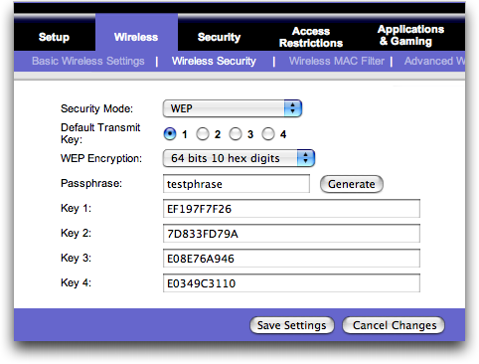
Wired Equivalent Privacy
Released as a Wi-Fi security standard in 1999
U.S restrictions on cryptographic technologies forced many devices to use only 64-bit encryption, later being lifted for 128-bit encryption (but it was too late)
Utilizes RC4 Stream Cipher– more on that in a minute
Deprecated since 2004 and SHOULD be phased out completely, but there are still appearances here and there…

Slide 7
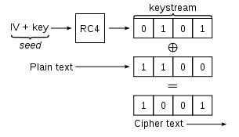
Wired Equivalent “Privacy”

Slide 8
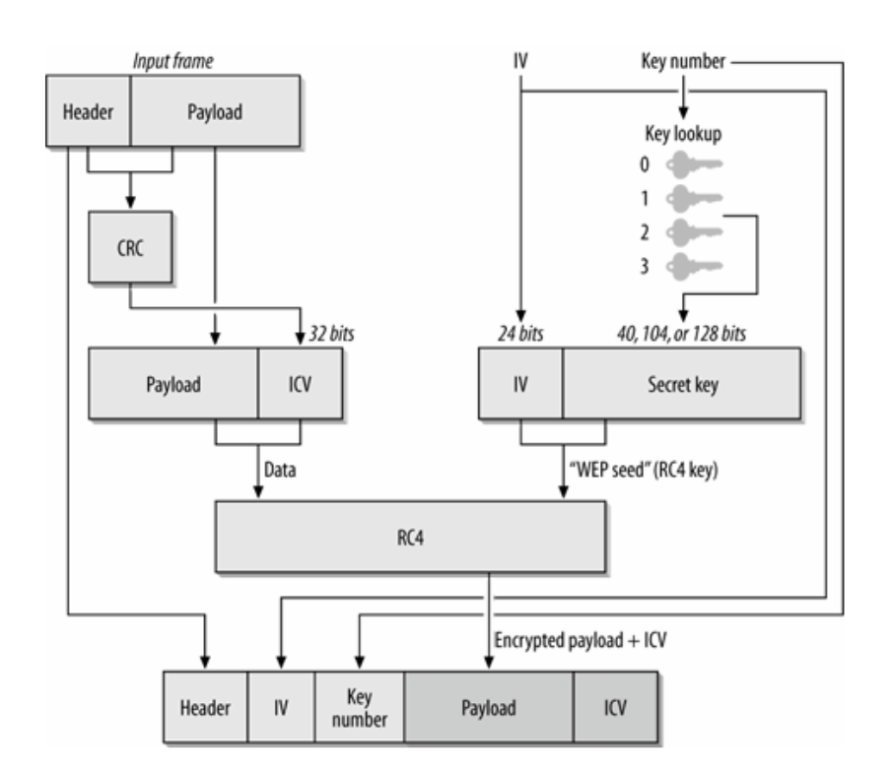
Wired Equivalent “Privacy”

Slide 9
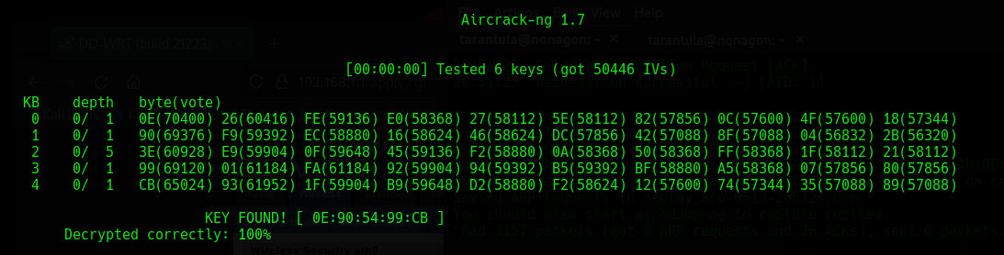
Wired Equivalent “Privacy”
24-bit IV (initialization vector) is used along with the shared key in the RC4 function
The IV is the only thing that changes in each packet…
The IV is eventually used more than once – a BIG no no in cryptography
If we can get the same ciphertexts from the same key stream, we can statistically attack to recover the plaintext
With a large amount of captured IVs, we can break 24-bit IV in minutes and obtain the shared key!

Slide 10

Defensive Strategies
Don’t use it.

Slide 11
WEP Demo Time!
SSID:
TheLANBeforeTimeLand

Slide 12

WPS
All you need is the right key…

Slide 13

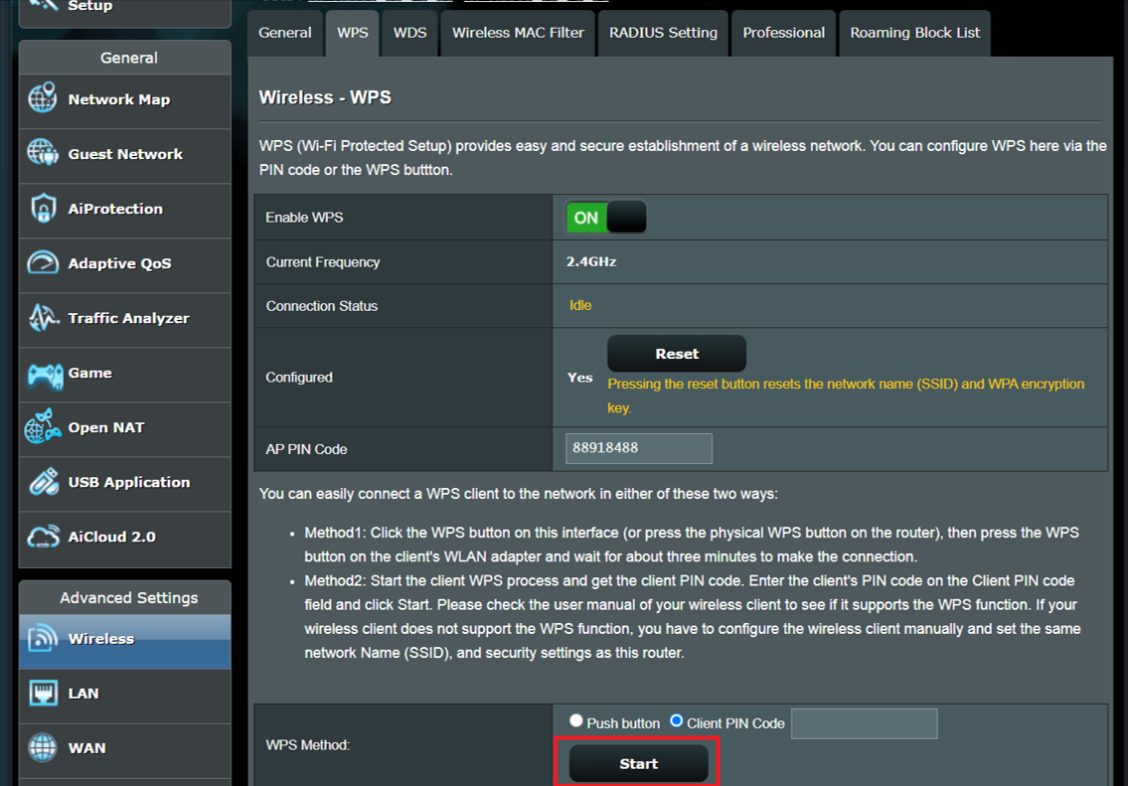
Wi-Fi Protected Setup
WPS v1.0 released in 2006
WEP was deprecated, and WPA(2) was the appropriate solution
WPS was released to help promote the transition between WEP and WPA clients
Involves a Registrar (Access Point) to issue and supply network configuration information (such as the WPA passphrase) to an Enrollee (client, end device)
The Enrollee can start a WPS-Authentication exchange with a Registrar that is configured with WPS (or in “active PIN mode”)
Exchange is successful and configuration information is given if the Enrollee provides the correct 8 (but actually 7) digit PIN code

Slide 14
Wi-Fi Protected Setup
8-digit PIN code? We can just spam codes until one connects…
True, but there is a much faster way!

Slide 15
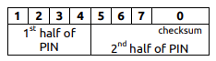
Wi-Fi Protected Setup
The WPS Pin is broken up into 2 halves:
There are 7 Messages in the WPS-Auth process
On Message 4 (M4), the Enrollee sends the first half of the PIN
If the Registrar sends a “EAP-NACK”, we know the first half is wrong
On Message 6 (M6), the Enrollee send the second half of the PIN
If the Registrar sends a “EAP-NACK”, we know the second half is wrong

Slide 16
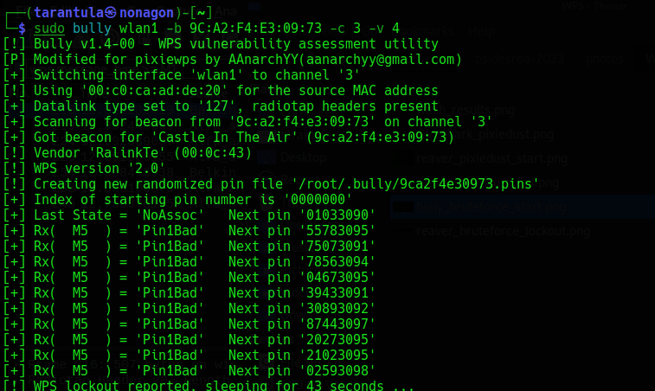
Wi-Fi Protected Setup 2.0
WPS 2.0 introduced in 2012
Required devices to enter a “permanent” WPS locked state upon at maximum 10 failed attempts
Was a good clean kill for most brute force attempts

Slide 17
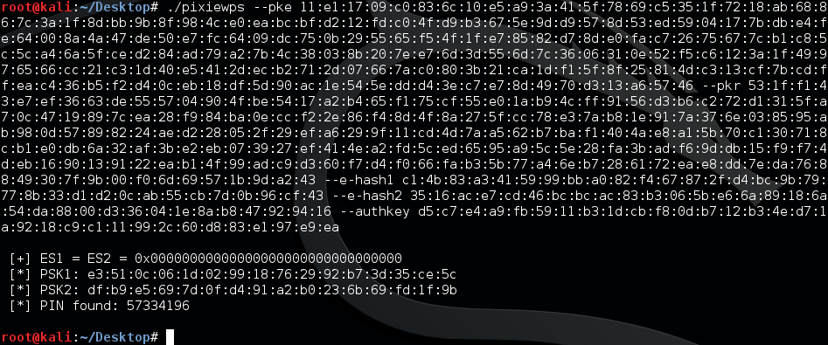
Wi-Fi Protected Setup 2.0
So let’s just not bruteforce!
2014 the “Pixie Dust” attack was introduced
Not all devices are vulnerable, but many manufacturers implemented weak or NO randomization during the generation of secrets in the WPS-Auth exchange
Only need to communicate with the Registrar up to M3, no actually guessing of the PIN is required
Fun math allows us to recover both halves of the PIN in minutes!

Slide 18
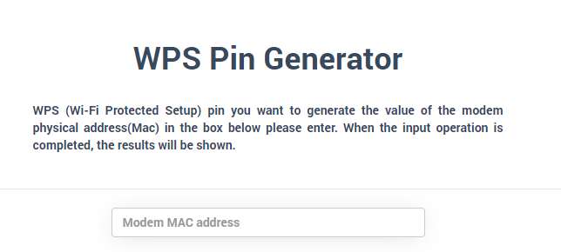
Wi-Fi Protected Setup 2.0
Can also try generating the PIN code!
Few algorithms found in router firmware that will generate a PIN code based on the MAC address
Cannot be relied on all the time, but better than bruteforcing to a lockout!

Slide 19
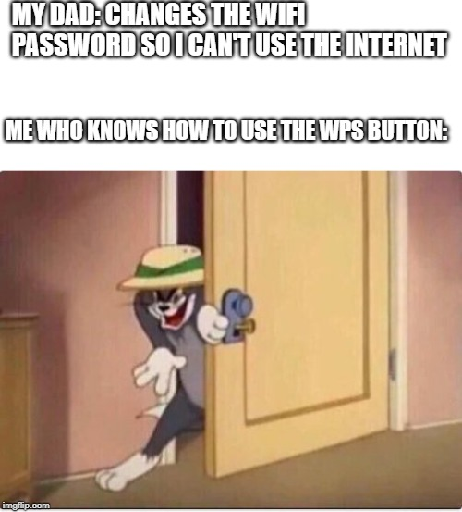
Defensive Strategies
Don’t use it.
If you do use it, investigate whether you can change the default set PIN and make sure it STAYS changed
Ensure the device is configured for WPS 2.0
Update that firmware!
Wireless/Network IDS can sniff for malicious or stray WPS packets/attempts
Limitting physical access to the device is crucial if you cannot turn WPS off!

Slide 20
WPS Demo Time!
SSID:
GammaKnife
The Castle In The Air

Slide 21

WPA
Just shake hands…

Slide 22

Wi-Fi Protected Access
WPA launched 2003, to directly take over the now virtually useless WEP
WPA1 introduced TKIP (Temporal Key Integrity Protocol), using the RC4 stream cipher yet again however utilizing a 128-bit PER packet key
Also phased out due to possible weaknesses allowing packet spoofing and re-injection
Shortly after, WPA2 came into play 2004
Introduced the usage of AES based encryption. This is what is still used today!
WPA(2)-Personal aka WPA-PSK (Pre-Shared Key) utilizes a 256-bit shared key to derive a 128-bit encryption key
Uses the “4-way Handshake” to generate these keys

Slide 23
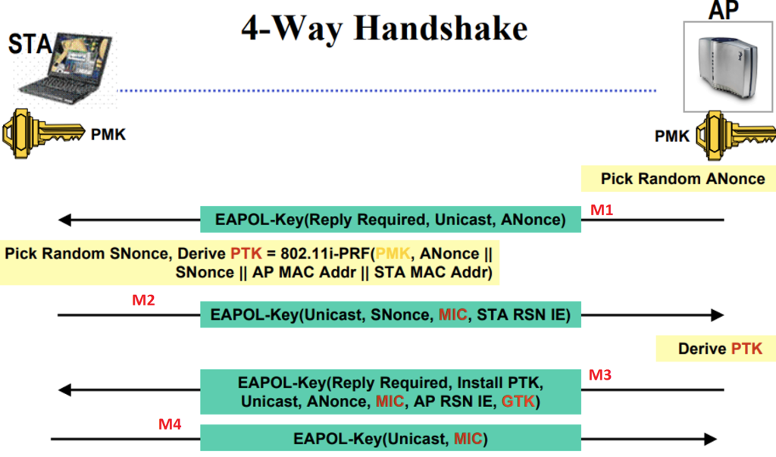
The Handshake (High Overview)

Slide 24
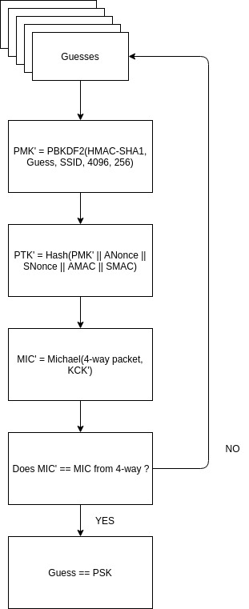
The Method
The passphrase is never actually sent over the wire
Both AP and Supplicant (client, end device) utilize password based key derivation functions (PBKDF2) to form the PSK, which is used directly as the PMK (Pairwise Master Key)
If we can capture the entire handshake transaction, we can bruteforce our way into correctly guessing the respective hashes!
Specifically interested in the Key Nonce and Key MIC values

Slide 25
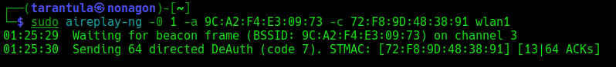
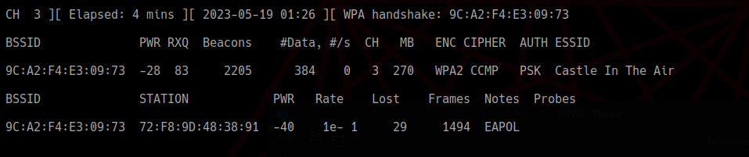
You WILL Shake Hands!
Using management frames, we can forcefully deauthenticate a user from their own network!
Keeping in mind we need to be relatively close to the target
With a device deauthenticated, it (almost) always has to reauthenticate and preform the 4 Way Handshake once again
The more silent method is to not deauthenticate a client at all and wait for a device to connect, but who knows when that will happen!

Slide 26

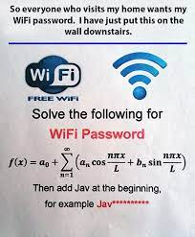
Defensive Strategies
Have a good, complicated passphrase
Avoid supporting TKIP
Update that firmware! (KRACK Attack)
Management Frame Protection (Cisco)
WPA3/802.11w
Beware of the “Transition Mode” – many APs broadcasting WPA3 also support WPA2!
*Might* cause some packet debugging issues down the line
Might take a while for IoT to catch up

Slide 27
WPA-PSK Demo Time!
SSID:
The Castle In The Air
GammaKnife

Slide 28

Thanks for Coming!
Feel free to play around with the APs listed previously for as long as they are up!
Bonus: Attempt to authenticate to the web management portal for each AP
Hint: The Castle In The Air’s login password starts with a capital letter, ends in a single digit number and might just be a song name similar to each SSID shown…
Ben Eldritch
BenTheCyberOne/KontraBear on Roanoke Discord!
thissiteissafe.com

